Slide 1
Cheesesteaks to Green Jell-O
From Philadelphia
To
Salt Lake City

Slide 2
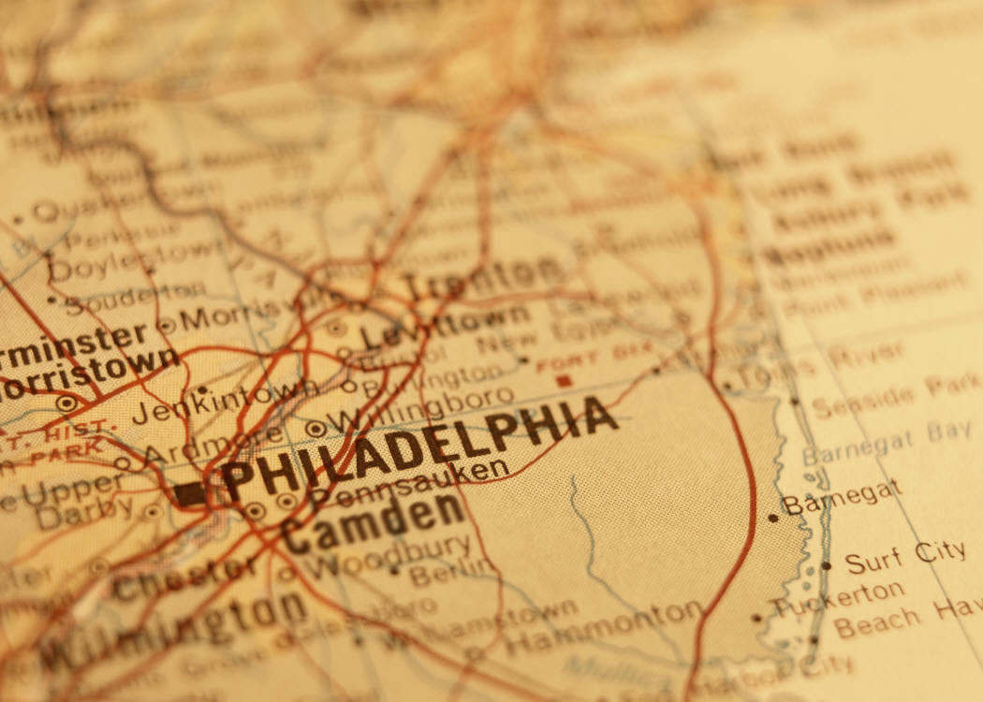
March 23,1956
Cookie is born to a single mom

Slide 3

1956-1962
WEST PHILADELPHIA
I was four or five years old and my mother and I lived with my Grandmother. There is a tavern called the Park Rail we lived on top of the bar. We had a side door entrance. The corner restaurant is where my best friend’s mom worked.
Notes:
I was four or five years old and my mother and I lived with my Grandmother.

Slide 4
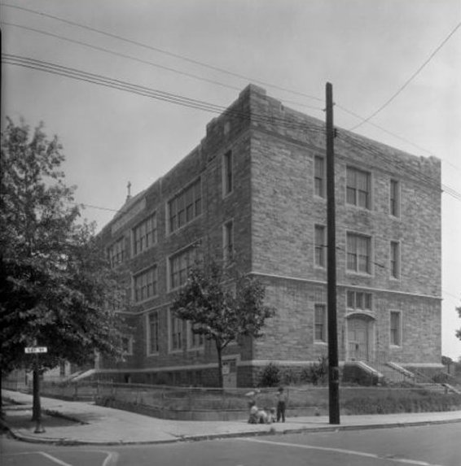
1962
Good Shepherd School
Moved to a new neighborhood to go to school. I could not attend the school in my old neighborhood. It was for Italian families only, your family needed to be at least one half Italian to attend.
I look back at my catholic education
As an important part of who I am.

Slide 5
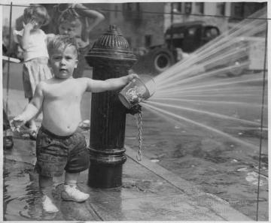
1962-1970
Fun Memories
Water Ice –Ice cold treat
Soft pretzel – Salty snack
Fire plug –Summer water fun
Trolley Car – City Transportation
Hoagies – Deli roll sandwiches
Uniform –Catholic Dress code
Taprooms- Neighborhood Taverns

Slide 6
The fun continues…
Mommy
My mother and I lived a near perfect life.
She was a rare woman.
She was unconventional is her parenting style.
Allowing me more freedom than most children.
We would talk about anything everything.
Nothing was off limits.

Slide 7
1969-1975
Let’s Get Serious
Slough School
Juvenile Court
Leave Home
Work/lived as a Nanny for a neighbor
Started using drugs
Lost four friends to drugs
Life going no where

Slide 8
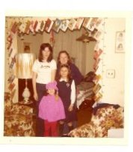
The Nanny
My other family. I started taking care of this family when the little one in pink was born. I took care of these young ladies for nearly six years. ( I am not the tall one)

Slide 9

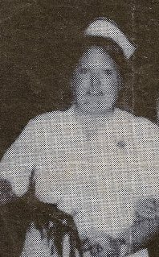
1975-1978
BREATHE
Returned Home
Moved to a small town(really small)
Attend College
Became a Mormon
Receive my Practical Nursing Degree
Started working as an LPN at a Senior Center
Just a little lonely

Slide 10
1978-1980
Just me, myself, and I
Life
is
sad
and
lonely………

Slide 11

1980
Never Would Have Guessed It!
Writing love letters (former missionary)
Invited to move to Utah ( same missionary)
“Oh My God I’m in Utah”
2000 miles away from home
Missionary is a jerk!!!
I am staying Anyway!
What are “roommates”
I have five of them, OMG
Have some Green Jell-O

Slide 12
1981
Green Jell-O Anyone?
Life in Utah
Hey Dad, they have pipes in under their lawns and sprinklers pop up to water the grass.
It was 110 degrees out today and I am not sweating. This is WONDERFUL!
I have lots of friends!

Slide 13
June Osler died July 22,1982
Hi there,
How are you, you know I still miss you. Me too mom…
So what’s new?
Well I don’t want you to worry. But it looks like the smoking finally caught up with me. They say I will need surgery and of course drugs too.
No you don’t have to come back……I will be fine. Let’s just wait and see.
Returned home February 1982, mother dies in July 22,1982

Slide 14
1983
Promise me you will go back!
Finally returned to Utah March 1983
Unemployed
Desperate
Took job at 7-11, Graveyard shift/Westside
Single
I need a change!

Slide 15
1985-
Living on the wild side
Hanging out with “the wrong” crowd
Party Time
Party Time
I am turning thirty

Slide 16

Ronald Clay Chesnut
1986-2006
'Cause I can't make you love me if you don't
You can't make your heart
feel something it won't.

Slide 17
We are a Family
Justin Clay December 19,1986
Kyle Wayne October 1,1989
You fill my heart with LOVE

Slide 18
The rest is History
With 7-11 1983-1993 Market Area Trainer Northern Utah.
Quit job for second child
Husband walks out.
No Money
LIFE REALLY SUCKS
Work in Child Care to be children
Children grown, still in childcare
We have each other, we are going to have some FUN

Slide 19
Let’s have some of that FUN
Oh! Look lets save that. Collecting junk
Story Time
Playground connoisseurs
Going to church
TMNT (Teenage Mutant Ninja Turtles)

Slide 20
Oh wait look there’s more!
Just when you think it’s over, and it’s time to grow old.
Something sneaks inside you and takes a hold.
Reminds you that you have way much more to do.
So enjoy it now, it’s all for you!
Oh My Heck Carol! Look at you! 2012

Slide 21
2012
Life In Review
This little project has been fun.
It has also been hard.
Looking back at one’s life can a trip down Memory Lane or trip down Memory Alley.
Luckily for me it was a pleasant trip.
I realized that though I had some lonely times in my life, I had some wonderful people who filled my life with joy and purpose.
I also realized that Fifty-Five years can fit into twenty-one power point slides.
I look forward to creating more slides to life and this power point

